Slide 1

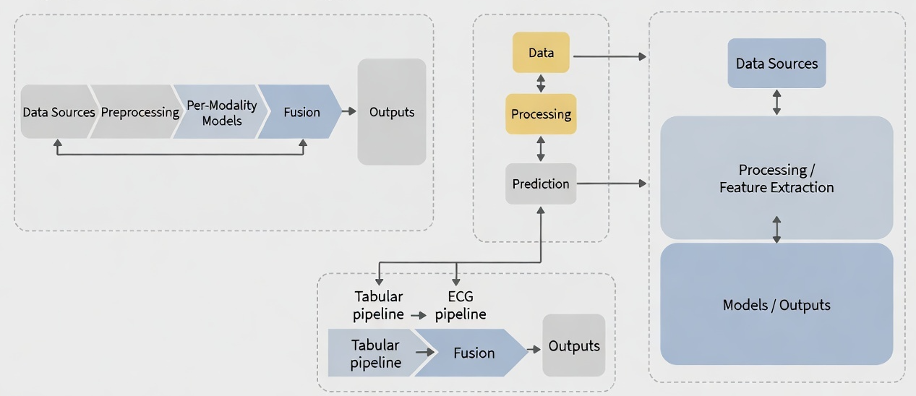
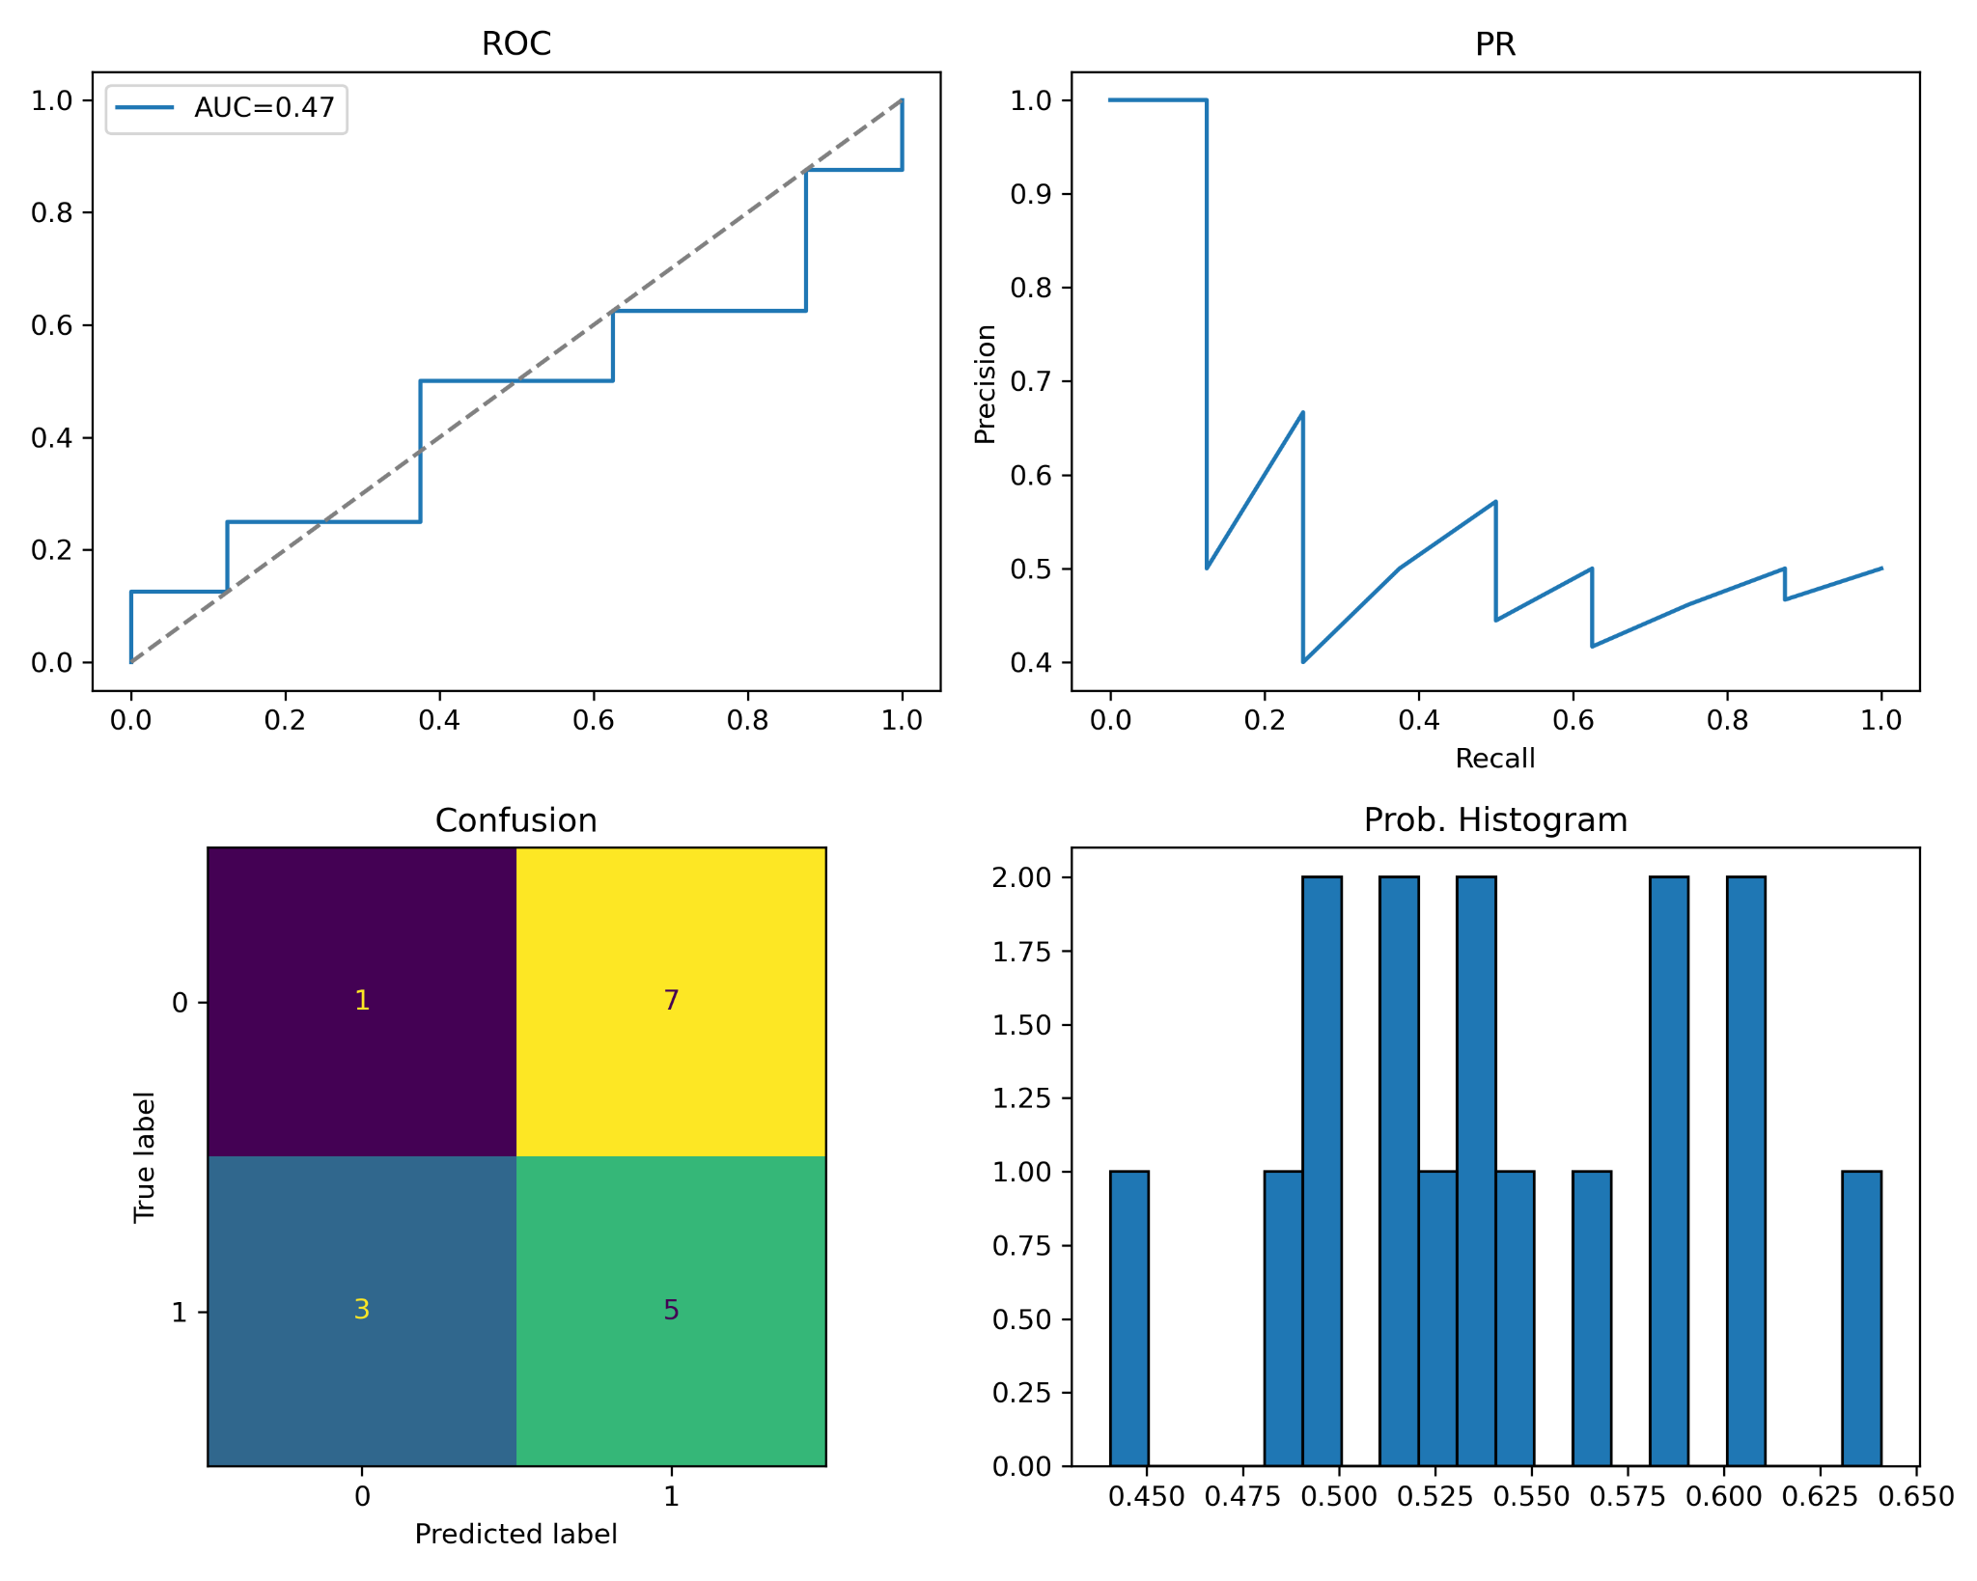
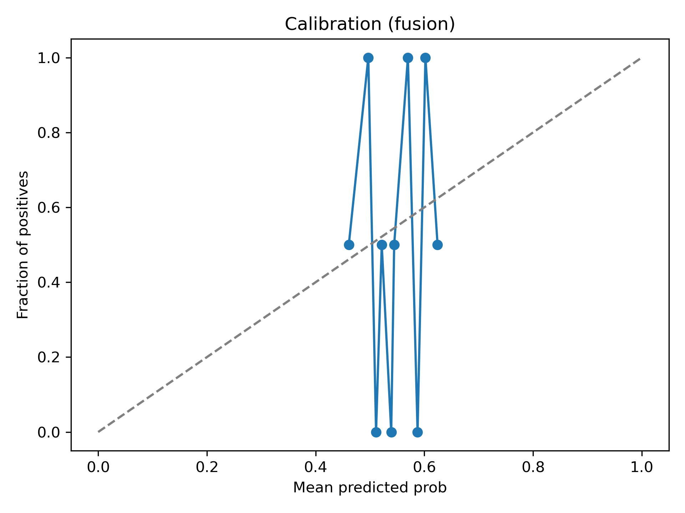
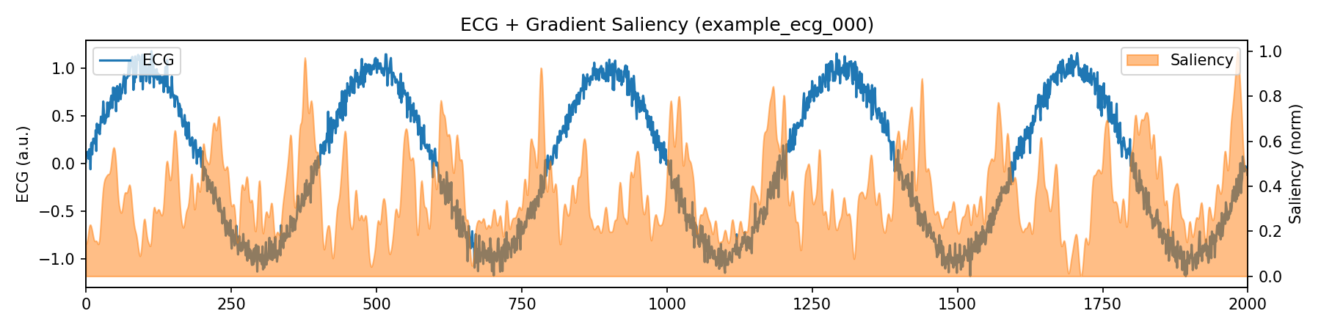
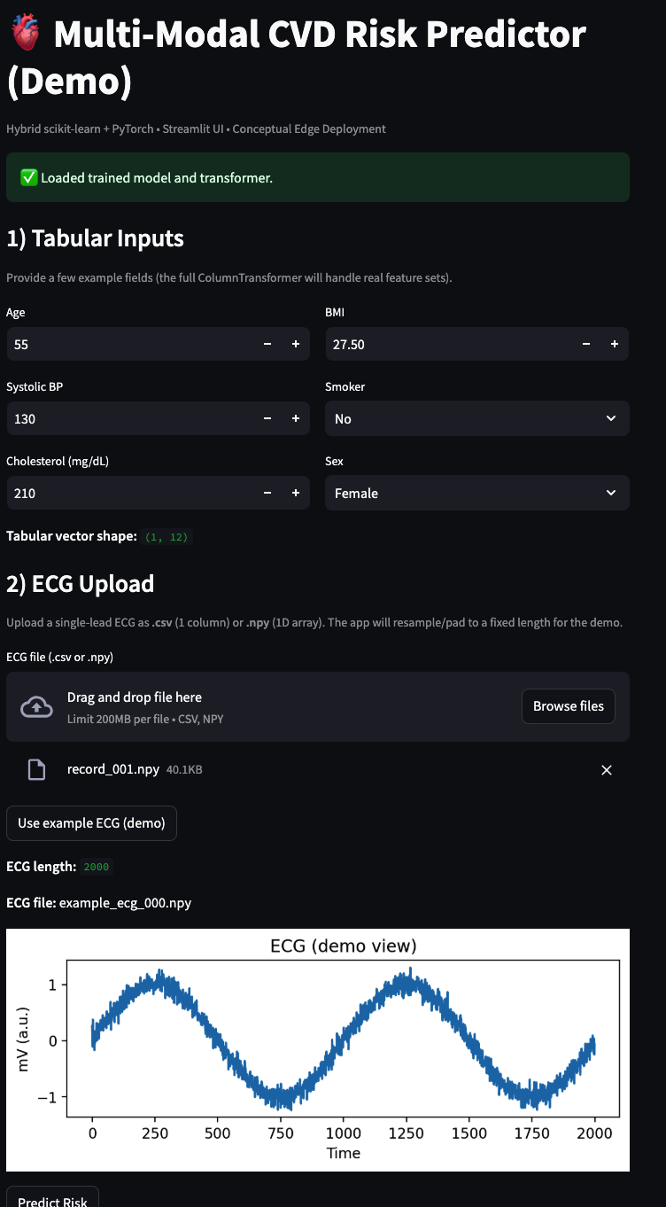
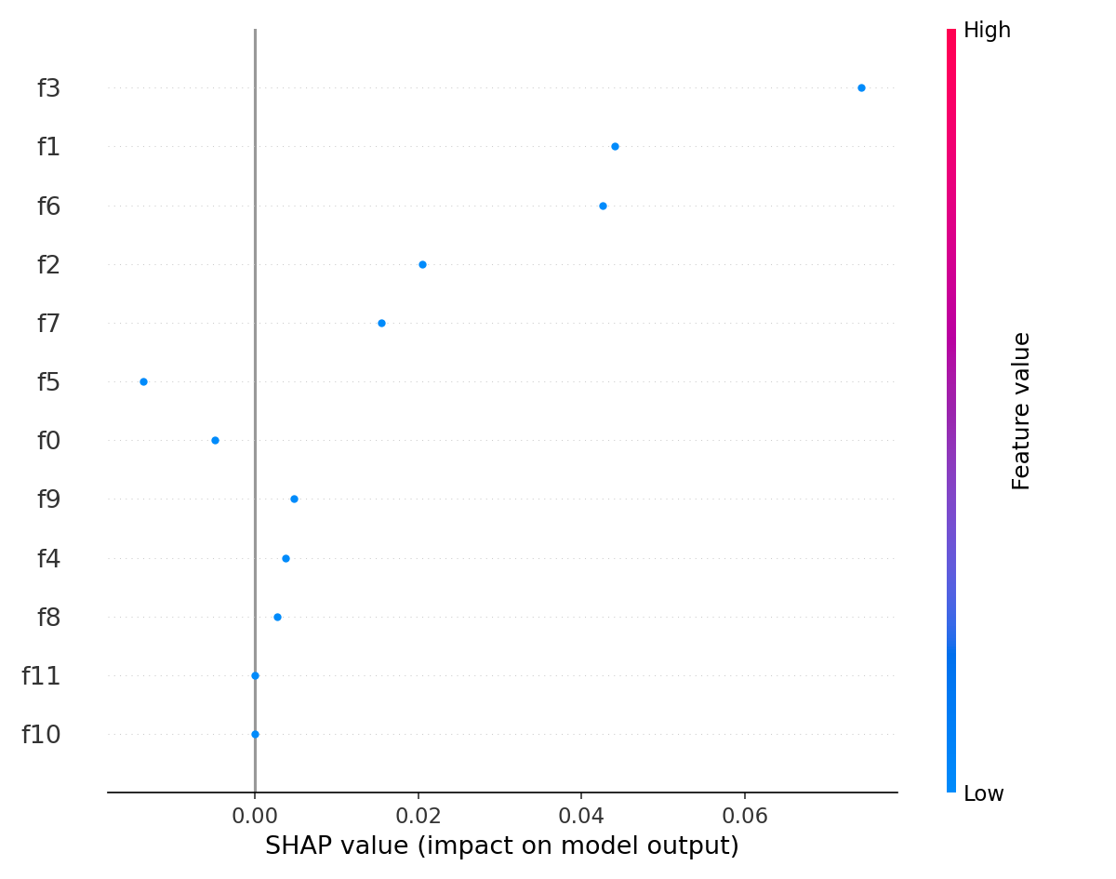
Multimodal Cardiovascular Risk Prediction from Clinical, Tabular, and ECG Signals
Angel Morenu — EEE 6778 – Applied Machine Learning II (Fall 2025)
Goal
System Architecture
Results & Error Analysis
Build a multi-modal system that fuses:
Demographic & Clinical tabular data, hospital admission information, and raw ECG signals to estimate cardiovascular disease (CVD) risk and support future edge deployment.
Problem & Motivation
Clinical need:
CVD remains a leading global cause of death. Risk scores are often based only on
tabular factors (age, BP, cholesterol) and ignore rich signal data from ECGs.
Challenge:
Heterogeneous data (structured + time series).
Small, imbalanced datasets.
Need for interpretable predictions to support clinical trust.
Vision:
A modular, reproducible pipeline that can eventually power:
point-of-care risk triage tools, and lightweight edge deployments (e.g., wearable sensors).
Figure 1. Fusion pipeline: scikit‑learn preprocessing for tabular & clinical features, 1‑D CNN+LSTM ECG encoder, followed by dense fusion layers with dropout and probability calibration.
Figure 4. Confusion matrix and calibration curve for the fusion model. Despite poor discrimination, calibration reflects the narrow probability range around 0.5.
Modeling & Training
• ROC curve shows near-random discrimination, driven primarily by the very small evaluation set.
• Precision–Recall curve highlights the impact of class imbalance and limited positive support.
• Prediction histogram reveals a narrow probability range centered near 0.5, indicating weak separation.
• Calibration curve demonstrates reasonably calibrated outputs despite low discriminative power.
• Baselines: Logistic Regression, Random Forest, XGBoost on tabular data.
• Fusion network implemented in PyTorch with BCE loss.
• Adam optimizer with mini‑batch training and early stopping.
• Metrics: AUC‑ROC, AUC‑PR, confusion matrix, Brier score, and calibration curves.
• Small test set used here to stress‑test calibration and error analysis.
Data & Pre‑processing
• Kaggle Cardiovascular Diseases dataset: tabular risk factors.
• Synthetic ECG waveforms used for prototype saliency analysis.
• Tabular pipeline: scikit‑learn Column Transformer (impute, scale, one‑hot encode).
• ECG pipeline: resample, band‑pass filter, window fixed‑length segments.
• Split into train/validation/test with patient‑level separation.
Interpretability: Saliency & SHAP
Figure 5. Live demonstration interface of the Multi-Modal CVD Risk Predictor.
• Streamlit UI accepts (1) tabular clinical variables that are automatically preprocessed by a scikit-learn ColumnTransformer, and (2) a raw single-lead ECG trace (uploaded as .csv or .npy).
Quantitative Results
Metric | Tabular | ECG | Fusion
Accuracy | 0.571 | 0.438 | 0.563
ROC AUC | 0.527 | 0.297 | 0.453
PR AUC | 0.560 | 0.375 | 0.526
Brier Score | 0.351 | 0.331 | 0.362
F1 Score | 0.609 | 0.526 | 0.588
Sensitivity | 0.700 | 0.625 | 0.625
Specificity | 0.455 | 0.250 | 0.500
Figure 2. Gradient‑based saliency overlaid on an ECG segment. The model focuses on QRS‑like complexes when predicting elevated risk.
Deployment Concept & Future Work
• Streamlit front‑end: interactive risk plots, SHAP explanations, and ECG saliency.
• Edge scenario: smartwatch concept that pushes alerts when calibrated risk crosses a threshold.
• Next steps: extend to real ECG datasets (e.g., PTB‑XL), perform cross‑validation, tune architectures, and add uncertainty estimates.
• Ethical lens: emphasize false‑positive burden, transparency, and data bias when moving toward real patients.
The fusion architecture yields increasing improvements over unimodal models, although absolute performance is constrained by the limited and imbalanced evaluation set. Probability estimates were refined using a Platt-scaled calibrator trained on held-out predictions (see accompanying calibration artifacts). All reported metrics are produced through a reproducible prediction and scoring pipeline. Deliverable 3 prioritizes stability, calibration quality, and interpretability over raw discriminative performance.
Figure 3. SHAP feature importance for the fusion model. Age, systolic BP, and ECG‑derived features dominate the risk score.

